Slide 1
Human Freedom Analysis Project
Scott Barnett
Meagan Colley
Jim Comas
Eden Dadi

Slide 2
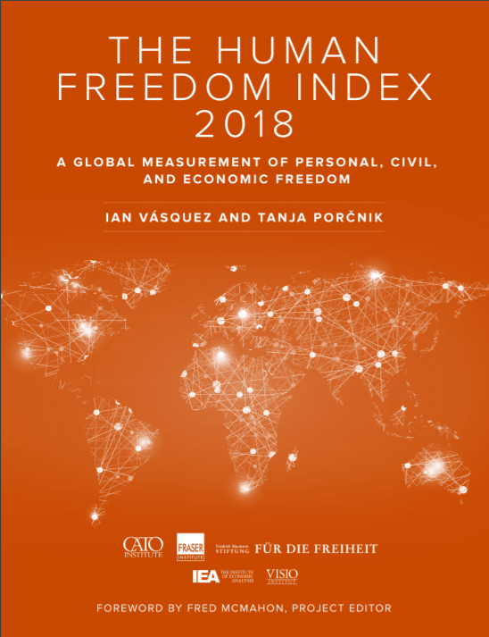
Human Freedom Analysis Project
Project purpose: Investigate relationships between the different scoring categories in the Human Freedom Index
“The Human Freedom Index presents the state of human freedom in the world based on a broad measure that encompasses personal, civil, and economic freedom…
The report is co-published by the Cato Institute, the Fraser Institute, and the Liberales Institut at the Friedrich Naumann Foundation for Freedom…”
https://www.cato.org/human-freedom-index-new
Notes:
The Human Freedom Index is a project that attempts to quantify human freedom -- identified in the report as “the absence of coercive constraint” -- on a per-country basis by measuring a wide variety of factors. We wanted to test the relationships between some of these factors to get a better idea of what drives freedom around the world. Data for the years 2008-2016 was taken from Kaggle and the HFI’s website at cato.org and imported into Jupyter Notebook in .csv format. We used a variety of python libraries to build the project including Pandas, NumPy, SciPy, Folium, and Matplotlib.

Slide 3
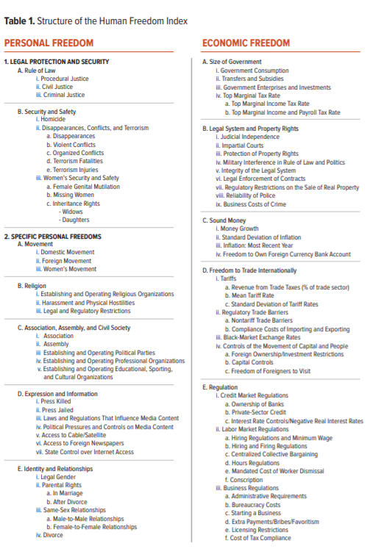
Human Freedom Index
The HFI is composed of categories, sub-categories and scores
Personal Freedom
Legal & Security
Specific Personal Freedoms
Economic Freedom
Size of Government
Legal system & Property Rights
Sound Money
Freedom to Trade Internationally
Regulation
Notes:
HFI score decompompises into 2 main categories (PF and EF). These deompose further subcategories and then leaf level scores. Ultimately 49 scores go into PF and 49 scores go into EF. These two main scores are summarized in the HF_index score

Slide 4
Human Freedom Index Data Exploration & Wrangle
Organized by
Country, ISO_code
Year: 2008 thru 2016 (9 years)
Region: (Caucasus & Central Asia, East Asia, Eastern Europe, Latin America & the Caribbean, Middle East & North Africa, North America, Oceania, South Asia, Sub-Saharan Africa, Western Europe)
Summary Freedom Scores
Human Freedom (HF)
Economic Freedom (EF)
Personal Freedom (PF)
Personal Freedom Scores
7 PF Categories
49 PF sub-categories and leaf level scores
Economic Freedom Scores
5 EF Categories
49 EF leaf level scores
Sourced from:
https://www.kaggle.com/gsutters/the-human-freedom-index
https://www.cato.org/human-freedom-index-new
Original Data shape
123 columns
1457 records with NaN’s
Post Wrangled Data shape
Index = countries
8 columns
1079 records
Notes:
Data is organized by country, yeaer and region
Summary scores by categor and HF
Data also provided rankings
Shape of dirty data is 123 x 1457 (with NaN’s)
Reduced set for variabes we investigated and dropna is 8 x 1079 reords

Slide 5
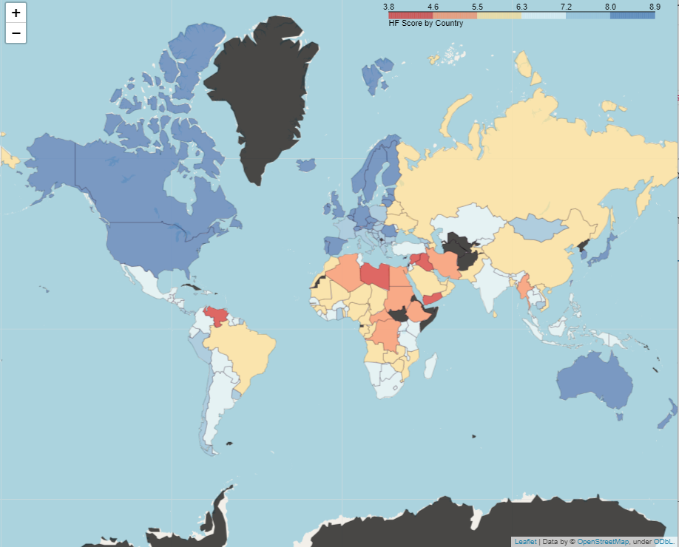
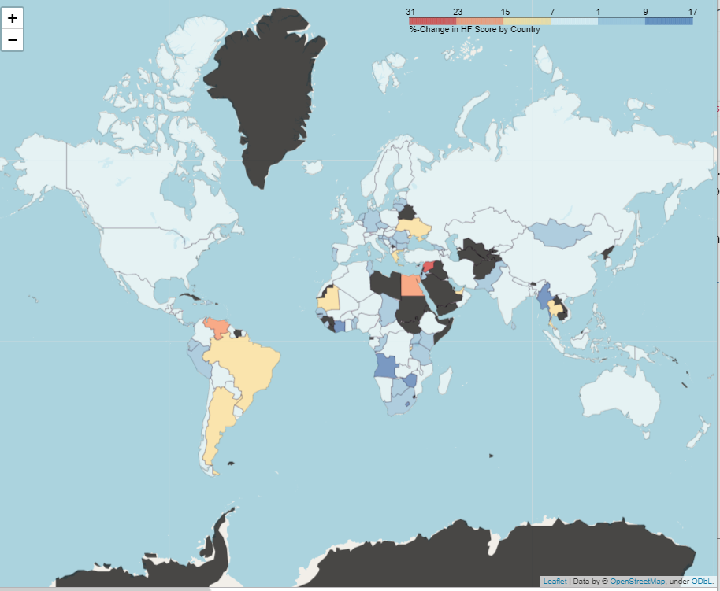
Geo Chart visual exploration
HF Score by Country (2016)
%-Change HF Score 2008 - 2016
Using Folium Python package: https://medium.com/datadriveninvestor/visualising-geospatial-data-with-python-d3b1c519f31
Notes:
Explored different ways to view and slice data
Used Folium package to plot HF score by country.
Did groupBy country and means to get at %-Change and plot (2nd chart)
Also tried groupBy Region

Slide 6
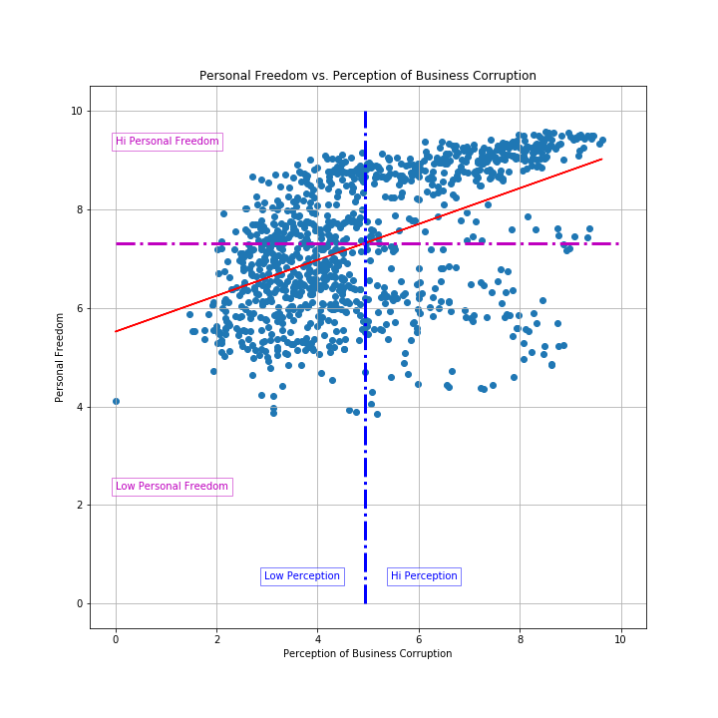
Binning Exploration
Hi-Lo Bins cut by Means
Score | Mean | Counts
Human Freedom (hf_score) | 7.106070 | HI 500 LOW 579
Personal Freedom (pf_score) | 7.318572 | HI 530 LOW 549
Economic Freedom (ef_score) | 6.893568 | HI 607 LOW 472
Money Growth (ef_money_growth) | 8.662144 | HI 648 LOW 428
Internet Expression (pf_expression_internet) | 8.575070 | HI 709 LOW 350
Perception Business Corruption (ef_regulation_business_bribes) | 4.945868 | HI 441 LOW 637
Notes:
Later in explored different binning methods and relationships thar follow
This shows Hi-Lo BIns where the cut is the Mean of the perception of businss corruption score
Not that the counts in the bins are not consistent. But hi-lo had logical meaning

Slide 7
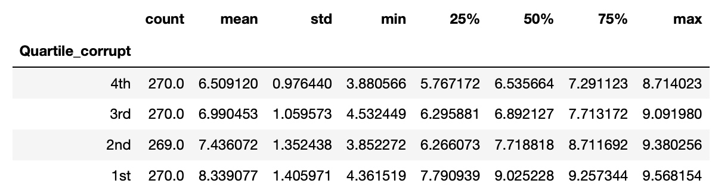
Binning Exploration - Quartile Bins
Used pd.qcut() function to divide the data into quartiles
“q=” parameter specifies number of bins to create, in this case 4
Notes:
Scott used quartile bins to cut the bins. Bin sizes are consistent. 25%, 50%, 75%, 100%. Meagan did a cut by 10 %tile to explore one of here questions.

Slide 8
HFI Questions
We investigated 4 questions to explore these relationships in the data
Personal Freedom vs. Human Freedom
Human Freedom vs. Money Growth
Human Freedom vs. Internet Expression
Personal Freedom vs. Perception of Business Corruptions

Slide 9
Q1: Economic Freedom vs. Personal Freedom
Question: Are personal freedom and economic freedom intertwined or are they independent of each other.
Hypothesis: If the personal freedom score is high then it can be expected that the economic freedom score will also be high.
Null Hypothesis: There is no correlation between the two variables.
Data: Personal Freedom Score and Economic Freedom Score (0=no freedom, 10=high freedom)

Slide 10
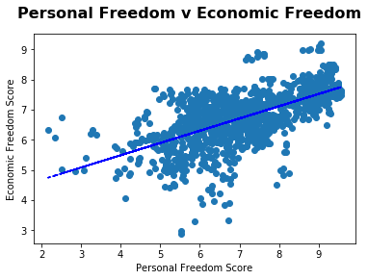
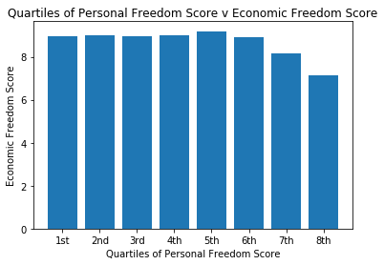
Q1: EF vs PF Plots and Tests

Slide 11
Q1: EF vs. PF - Conclusions
p-value = 3.92e-155
This p-value is very low which indicates the null should be dismissed
However the bar graph visually implies that there is no significant relationship between the variable

Slide 12
Q2: Personal Freedom vs. Money Growth
Question: Do countries with higher income have more personal freedom?
Hypothesis: If a state has a higher score in money growth then it will likely have a higher personal freedom score
Null Hypothesis: There is no relationship between the two variables
Data: Personal Freedom Score and Money Growth (0= no freedom or growth, 10= high freedom or growth)

Slide 13
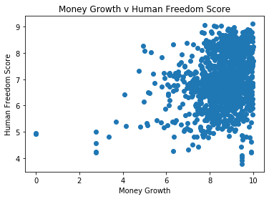
Q2: PF vs Money Growth Plots and Tests

Slide 14
Q2: PF vs Money Growth - Conclusions
Independent T-test returned a p-Value of 2.64e-284
Because the p-Value is so low we can dismiss the null hypothesis
The graph suggests a positive correlation

Slide 15
Q3: Human Freedom vs Internet Freedom
Question: Does the personal freedom of internet expression affect human freedom?
Hypothesis : There is a relationship between freedom of internet expression and human freedom
Null Hypothesis : There is no relationship between freedom of internet expression and human freedom.
Data : State Control of Internet Access (0 = no freedom of Internet access; 10 = complete freedom of navigation and publication. Discrete values)

Slide 16
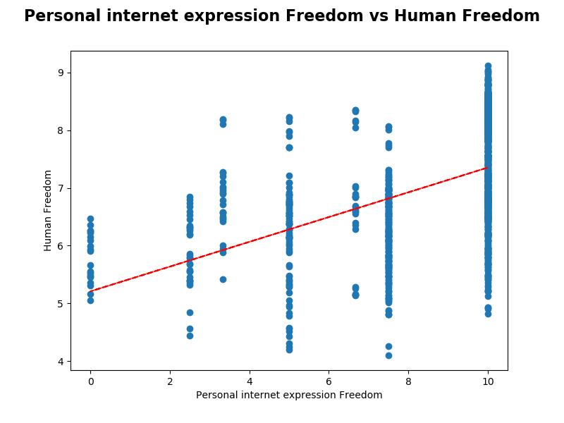
Q3: HF vs Internet Freedom Plots and Tests
Created a plot between the personal internet expression freedom and human freedom.

Slide 17
Q3: HF vs Internet Freedom - Conclusions
x-axis (personal internet expression) changes when y-axis (human freedom) increases.
Regression Line p-value = 6.29082e-66
The t-test was statistically significant.
p-value = 6.52495e-77
But scatter plot inconclusive
Could possibly conclude that low personal internet expression is related to low human freedom score
But high personal internet freedom does not seem to imply anything about human freedom score

Slide 18
Q4: Personal Freedom vs Perceived Business Corruption
A question from original survey in Global Competitiveness Report: Do illegal payments aimed at influencing government policies, laws, or regulations have an impact on companies in your country? (1 = significant negative impact, 10 = no impact at all)
Hypothesis: Countries that score highly on this metric (i.e., less corrupt) will also report higher personal freedom scores.
Null Hypothesis: There is no relationship between perceived corruption and personal freedom.

Slide 19
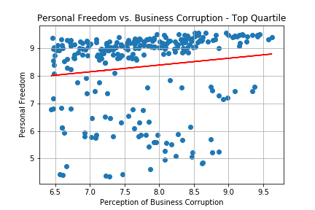
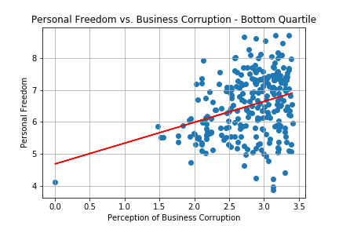
Q4: Personal Freedom vs Perceived Business Corruption - Plots and Tests
Created a scatterplot and ran a linear regression for the top and bottom quartiles of perceived corruption

Slide 20
Q4: Personal Freedom vs Perceived Business Corruption - Conclusions
Top quartile:
r² = 0.019
p-value = 0.023
Bottom quartile:
r² = 0.094
p-value = 2.579 * 10⁻⁷
Both models are statistically significant, but explain very little of the variance in personal freedom. This makes sense, as perceived business corruption is a subcomponent of economic regulation, which was not part of the personal freedom category in the original study.

Slide 21
Conclusion
Further statistical analyses such as multiple regressions or clustering the data may be used to uncover future trends
Within the scope of this project, however, our focus was primarily on attempting to qualify basic relationships within subsets of the data and using our findings to determine whether any basis exists for future research

Slide 22
Retrospective & Lessons Learned
Put wrangled data into csv file that can be read and used by all vs. repeating cleanup code in each notebook
GIT issues. Easy to unintentionally modify a jupyter notebook.
‘git checkout .’ or ‘git restore filename’ are your friends
Allow time for all to explore the data and possible explorations
Time to norm and storm as team and focus project (1 hr not enough)
Binning opened up additional paths of exploration later in the project.
Agree to a code freeze date.

Slide 23
Retrospective & Lessons Learned
It pays to double check, in the instance of Ef Score v Pf Score the analysis returned contradictory outcomes
Consult with team and coaches on what we are seeing in the plots and status
It’s a learning journey. Grace abounds.

Slide 24
Human Freedom Index Table
Year, ISO_code, countries, region
Personal Freedom
pf_rol_proceduralProcedural justice
pf_rol_civilCivil justice
pf_rol_criminalCriminal justice
pf_rolRule of law
pf_ss_homicideHomicide
pf_ss_disappearances_disapDisappearances
pf_ss_disappearances_violentViolent conflicts
pf_ss_disappearances_organizedOrganized conflicts
pf_ss_disappearances_fatalitiesTerrorism fatalities
pf_ss_disappearances_injuriesTerrorism injuries
pf_ss_disappearancesDisappearances, conflict, and terrorism
pf_ss_women_fgmFemale genital mutilation
pf_ss_women_missingMissing women
pf_ss_women_inheritance_widowsInheritance rights for widows
pf_ss_women_inheritance_daughtersInheritance rights for daughters
pf_ss_women_inheritanceInheritance
pf_ss_womenWomen's security
pf_ssSecurity and safety
pf_movement_domesticFreedom of domestic movement
pf_movement_foreignFreedom of foreign movement
pf_movement_womenWomen's movement
pf_movementFreedom of movement
pf_religion_estop_establishFreedom to establish religious organizations
pf_religion_estop_operateFreedom to operate religious organizations
pf_religion_estopFreedom to establish and operate religious organizations
pf_religion_harassmentHarassment and physical hostilities
pf_religion_restrictionsLegal and regulatory restrictions
pf_religionReligious freedom
pf_association_associationFreedom of association
pf_association_assemblyFreedom of assembly
pf_association_political_establishFreedom to establish political parties
pf_association_political_operateFreedom to operate political parties
pf_association_politicalFreedom to establish and operate political parties
pf_association_prof_establishFreedom to establish professional organizations
pf_association_prof_operateFreedom to operate professional organizations
pf_association_profFreedom to establish and operate professional organizations
pf_association_sport_establishFreedom to establish educational, sporting, and cultural organizations
pf_association_sport_operateFreedom to operate educational, sporting, and cultural organizations
pf_association_sportFreedom to establish and operate educational, sporting, and cultural organizations
pf_associationFreedom to associate and assemble with peaceful individuals or organizations
pf_expression_killedPress killed
pf_expression_jailedPress jailed
pf_expression_influenceLaws and regulations that influence media content
pf_expression_controlPolitical pressures and controls on media content
pf_expression_cableAccess to cable/satellite
pf_expression_newspapersAccess to foreign newspapers
pf_expression_internetState control over Internet access
pf_expressionFreedom of expression
pf_identity_legalLegal gender
pf_identity_parental_marriageParental rights in marriage
pf_identity_parental_divorceParental rights after divorce
pf_identity_parentalParental rights
pf_identity_sex_maleMale-to-male relationships
pf_identity_sex_femaleFemale-to-female relationships
pf_identity_sexSame-sex ralitionships
pf_identity_divorceDivorce
pf_identityIdentity and relationships
pf_scorePersonal Freedom (score)
pf_rankPersonal Freedom (rank)
Economic Freedom
ef_government_consumptionGovernment consumption
ef_government_transfersTransfers and subsidies
ef_government_enterprisesGovernment enterprises and investments
ef_government_tax_incomeTop marginal income tax rate
ef_government_tax_payrollTop marginal income and payroll tax rate
ef_government_taxTop marginal tax rate
ef_governmentSize of government
ef_legal_judicialJudicial independence
ef_legal_courtsImpartial courts
ef_legal_protectionProtection of property rights
ef_legal_militaryMilitary interference in rule of law and politics
ef_legal_integrityIntegrity of the legal system
ef_legal_enforcementLegal enforcement of contracts
ef_legal_restrictionsRegulatory restrictions on the sale of real property
ef_legal_policeReliability of police
ef_legal_crimeBusiness costs of crime
ef_legal_genderGender adjustment
ef_legalLegal system and property rights
ef_money_growthMoney growth
ef_money_sdStandard deviation of inflation
ef_money_inflationInflation: most recent year
ef_money_currencyFreedom to own foreign currency bank account
ef_moneySound money
ef_trade_tariffs_revenueRevenue from trade taxes (% of trade sector)
ef_trade_tariffs_meanMean tariff rate
ef_trade_tariffs_sdStandard deviation of tariffs rates
ef_trade_tariffsTariffs
ef_trade_regulatory_nontariffNontariff trade barriers
ef_trade_regulatory_complianceCompliance costs of importing and exporting
ef_trade_regulatoryRegulatory trade barriers
ef_trade_blackBlack-market exchange rates
ef_trade_movement_foreignForeign ownership/investment restrictions
ef_trade_movement_capitalCapital controls
ef_trade_movement_visitFreedom of foreigners to visit
ef_trade_movementControls of the movement of capital and people
ef_tradeFreedom to trade internationally
ef_regulation_credit_ownershipOwnership of banks

